Slide 1
India Developer Roadshow
27th June – 1st July 2017

Slide 2


Modernizing Air Traffic Control
Sanjay Saxena
Developer Advocate
Emerging Technologies
June 2017
© 2017 IBM Corporation

Slide 3
Agenda
Motivation
Radar-based Air Traffic Management
Issues with Radar-based Air Traffic Management
ADS-B 101
ADS-B based Ground Stations
Cloud-based Air Traffic Control
Flight Tracking and Augmented Reality
Demo
Notes:
Disclaimer – I am not an aviation expert or a pilot. The aviation related material in this presentation has been simplified/dumbed-down for an average joe developer to understand.

Slide 4
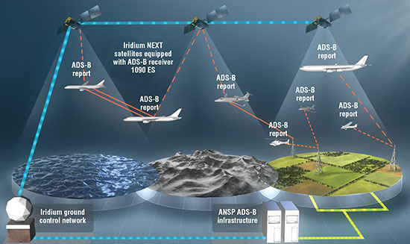


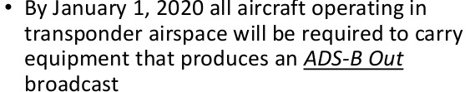
Motivation – Why do we care?
Crowded Air Space
Compliance with new regulations
Bring Air Traffic Control to the 21st century
Notes:
Airlines are projecting robust growth for next few decades. In future, drones are expected to deliver goods. And, UberChoppers is becoming a reality – which means airspace is going to be increasingly crowded. Which means that the current radar-based air traffic system will not be able to scale.
FAA was already anticipating this and has now introduced regulation that mandates all aircrafts operating in the US airspace to broadcast ADS-B messages by Jan 2020.
This means we have an excellent opportunity to bring our considerable technical expertise to bear and take advantage of some of the opportunities in this space.

Slide 5
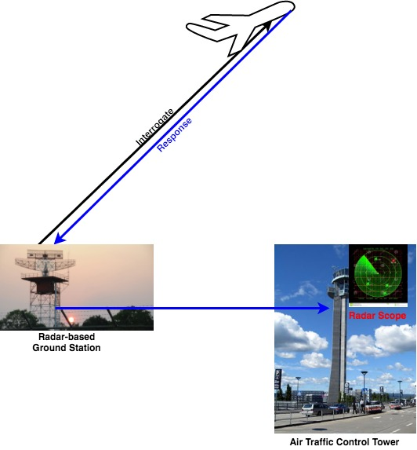
Radar-based Air Traffic Management
Notes:
Very simplistic representation of Radar-based Air Traffic Management. It’s much more complicated than this with Primary Surveillance Radars and Secondary Surveillance Radars and such. But, we don’t need to worry about that complexity here.
Essentially, the way Radar-based ATM works is -- high frequency radio waves are bounced from fixed terrestrial antennas off of airborne targets and the reflected signals/response is then interpreted.
Radar on top of the Ground Station sends a signal or an interrogation beam that causes aircrafts transponder to reply and provide information such as it’s position, altitude, etc.
As traffic increases, a single interrogation beam may container responses from a number of aircrafts. This will cause the go-arounds

Slide 6
Issues with Radar-based Air Traffic Management
No visibility to the aircraft traffic
No access to weather/terrain info
Totally rely on human air traffic controllers
No radar coverage in remote areas
Cannot fly directly from Point A to Point B → more fuel, more time → more expensive → less eco-friendly
Multiple go-arounds

Slide 7
ADS-B 101
Automatic – Always on. No interrogation required
Dependent – Depends on GNSS for GPS coordinates
Surveillance
Position
Altitude
Velocity Vector
Call Sign, etc.
Broadcast
1090MHz frequency
Ground Stations or other aircrafts can receive messages
Open Standard Wire Protocol
Notes:
ADS-B is redefining the paradigm of Communication – Navigation – Surveillance in Air Traffic Management.
FAA has mandated by 2020 all commercial aircrafts flying in the US airspace should support avionics equipment that would broadcast ADS-B messages.
The reasons why ADS-B is very interesting is because – a) it is an open standard application layer wire-level protocol with a specification, b) it is being broadcasted on 1090MHz in clear text!!! It means that we can listen/pickup those ADS-B messages coming directly from flights and do something with them.

Slide 8
Radar vs ADS-B Cont…
Radar
No visibility to the aircraft traffic
No access to weather/terrain info
Totally rely on human air traffic controllers
No radar coverage in remote areas
Cannot fly directly from Point A to Point B → more fuel, more time → more expensive → not eco-friendly
Multiple go-arounds
ADS-B
Visibility to the aircraft traffic
Access to weather/terrain info
Less reliance on human air traffic controllers
No need for radar coverage
Can fly directly from Point A to Point B → less fuel, less time → less expensive → very eco-friendly
No more go-arounds

Slide 9
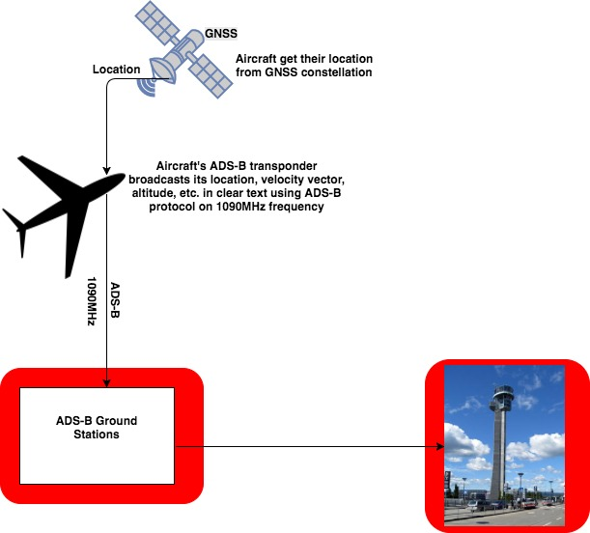
Challenges with ADS-B Adoption
New Ground Stations
Upgrades to Air Traffic Control
Capital Intensive
Looming FAA Deadline – Jan 2020

Slide 10
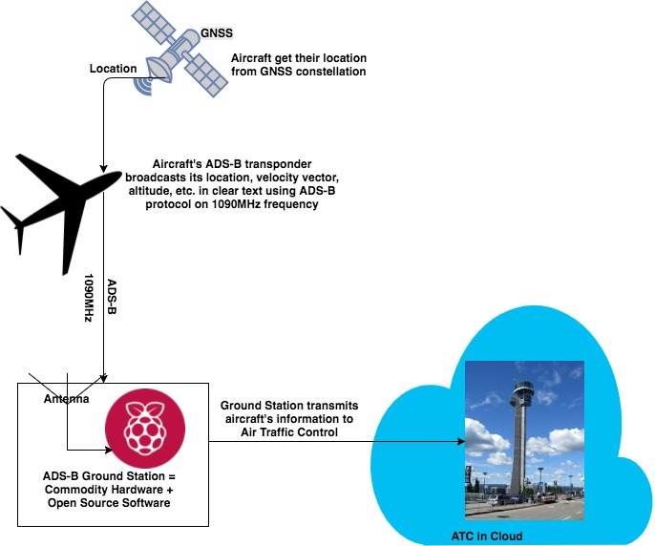
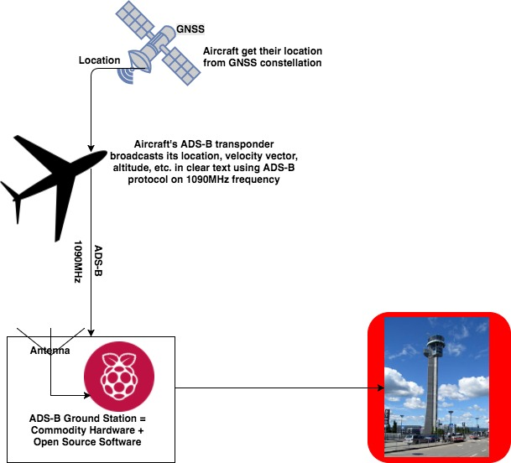
Opportunities with ADS-B Adoption
Messages are broadcasted in clear text
Messages are broadcasted on 1090MHz frequency
Radio tuned to 1090MHz frequency can pick up messages
Open source libraries can decode the messages
Commodity Hardware + Open Source Software → ADS-B Ground Station
Centralized, secure, reliable, and scalable Air Traffic Control in the Cloud

Slide 11
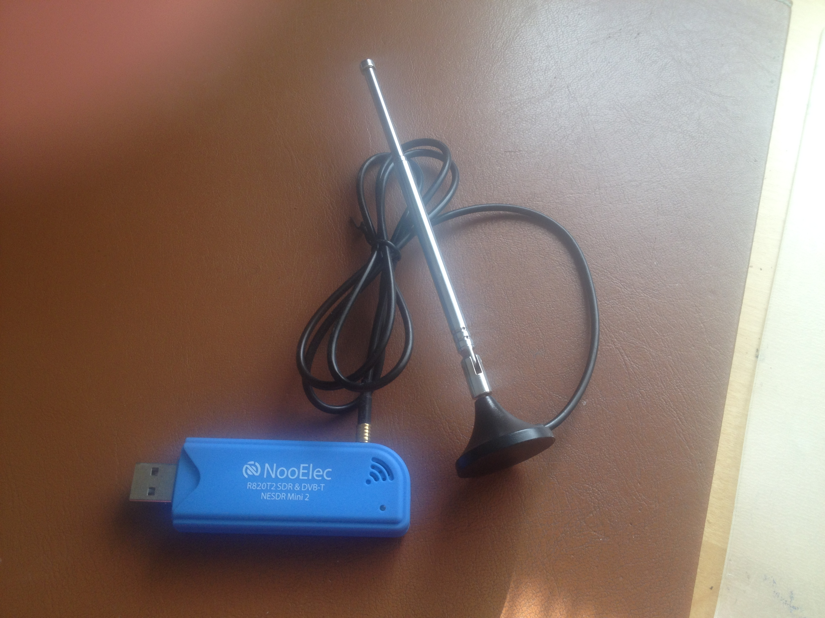
ADS-B based Ground Station
Commodity Hardware
https://github.com/MalcolmRobb/dump1090
Software Defined Radio(SDR) receiver with antenna and USB interface
https://github.com/ibm/air-trffic-control
Raspberry Pi
Open Source Software
Dump1090 – Tunes the SDR to 1090MHz, receives ADS-B messages, and makes them available on TCP port
ADS-B Decoder and MQTT Publisher
ADS-B Ground Station → $50 IoT Device!!

Slide 12
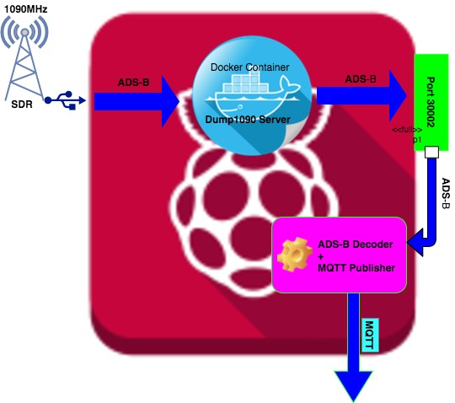
ADS-B based Ground Station Cont..

Slide 13




Cloud-based Air Traffic Control
IoT Platform
Streaming Analytics -- Optional
JSON
Weather API
Notes:
IoT Platform provides powerful application access to IoT devices and data to help you rapidly compose analytics applications. This platform provides secure communication to and from IoT devices by using MQTT and TLS
Weather API as the name suggests is a REST API to retrieve weather for a given coordinate/location.

Slide 14
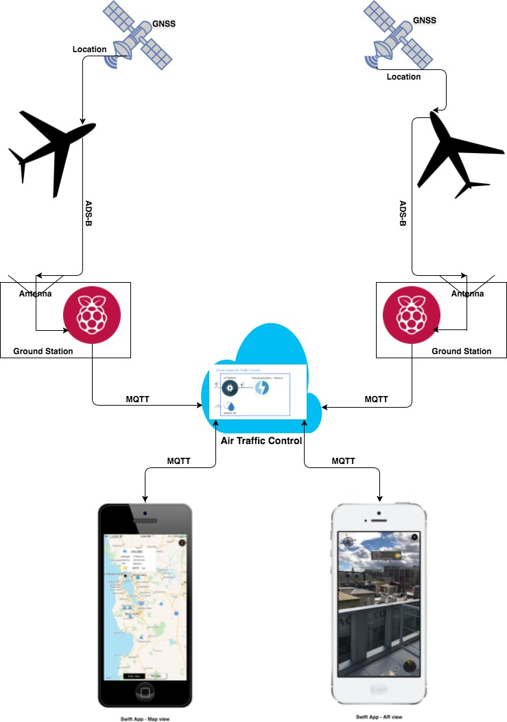
Flight Tracking with Augmented Reality
Notes:
This slide shows how things work with ADS-B in the picture.
Aircrafts receive GPS coordinates from GNSS constellation. The aircrafts then broadcast ADS-B messages on 1090MHz frequency that can be picked up by other planes in the vicinity and Ground Stations that are equipped with an antenna tuned to 1090MHz.
Ground Stations decode ADS-B messages and create MQTT messages which are published to the cloud.
MQTT messages are then received by the smart devices and the flights are rendered using Augmented Reality. So, instead of using radar scopes to track flights, air-traffic-controllers can use tablets and smart devices to track flights.

Slide 15
Demo
{{{demo}}}

Slide 16


Summary
Air Traffic Management …
FAA deadline 2020 for ADS-B compliance
ADS-B Open Source Technology
Raspberry Pi Powered ADS-B Ground Stations using SDR with antenna and USB
Air Traffic Control in Cloud
Flight Tracking using Augmented Reality
Try it now!
https://github.com/ibm/air-traffic-control

Slide 17


Please give us your valuable feedback
http://ibm.biz/devconnect17/

Slide 18




Stay Connected and continue coding !
Code & instructions available here https://github.com/IBMDevConnect17/
Join our Meetup groups
Mumbai : https://www.meetup.com/Cloud-Mumbai-Meetup/
Hyderabad: https://www.meetup.com/Hyderabad-Cognitive-with-Cloud
Bangalore : https://www.meetup.com/IBMDevConnect-Bangalore
Join developerWorks India Community
https://developer.ibm.com/in/
Check out the cool developer journeys
https://developer.ibm.com/code/
Join our Slack team and stay in touch with the experts
https://ibmdevconnect.slack.com
Send in your request to - http://ibm.biz/slackrequest

